Slide 1
Weather Data Analysis
Monthly Climate Stations

Slide 2
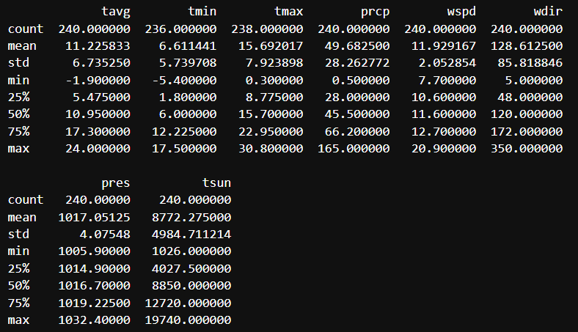
Statistics of Climate data

Slide 3
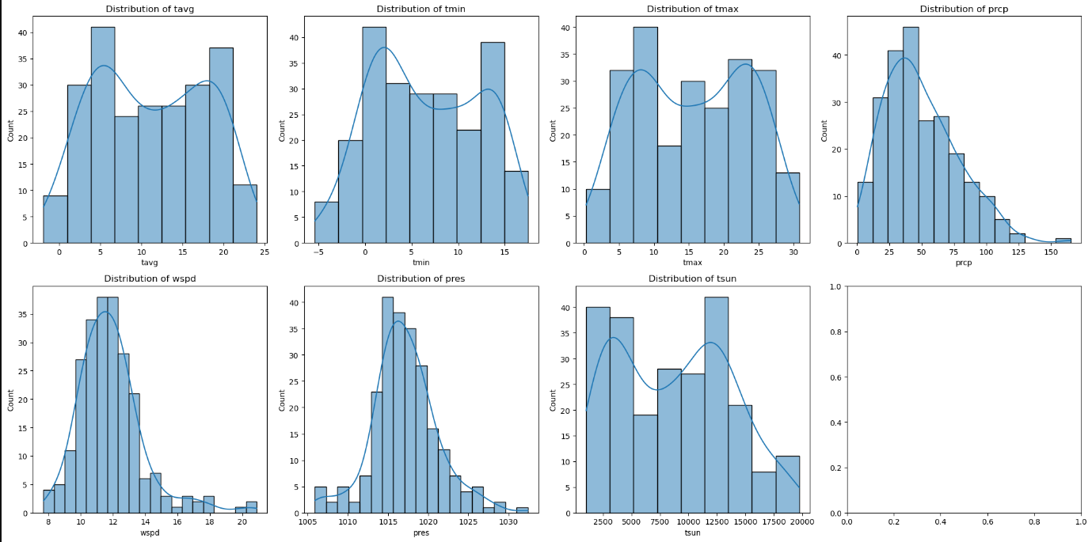
Distribution of Parameters

Slide 4
Distribution Analysis
Histogram and KDE Plots:
Average Temperature (tavg): Shows a bell-shaped curve, indicating a normal distribution. This suggests that average temperatures vary around a central value with most data points clustering near this average.
Minimum Temperature (tmin): Similarly, this distribution also appears normal, reflecting typical seasonal variations.
Maximum Temperature (tmax): Shows normal distribution with peaks around certain temperatures, which might be influenced by seasonal weather patterns.
Precipitation (prcp): Skewed distribution, indicating a right-skewed pattern with many days of low precipitation and fewer days of high precipitation.
Wind Speed (wspd): Shows a distribution with a peak at lower wind speeds, indicating that calm conditions are more common.
Pressure (pres): Appears normally distributed, reflecting typical atmospheric pressure variations.
Sunshine (tsun): Distribution might show variations based on geographical and seasonal factors.

Slide 5
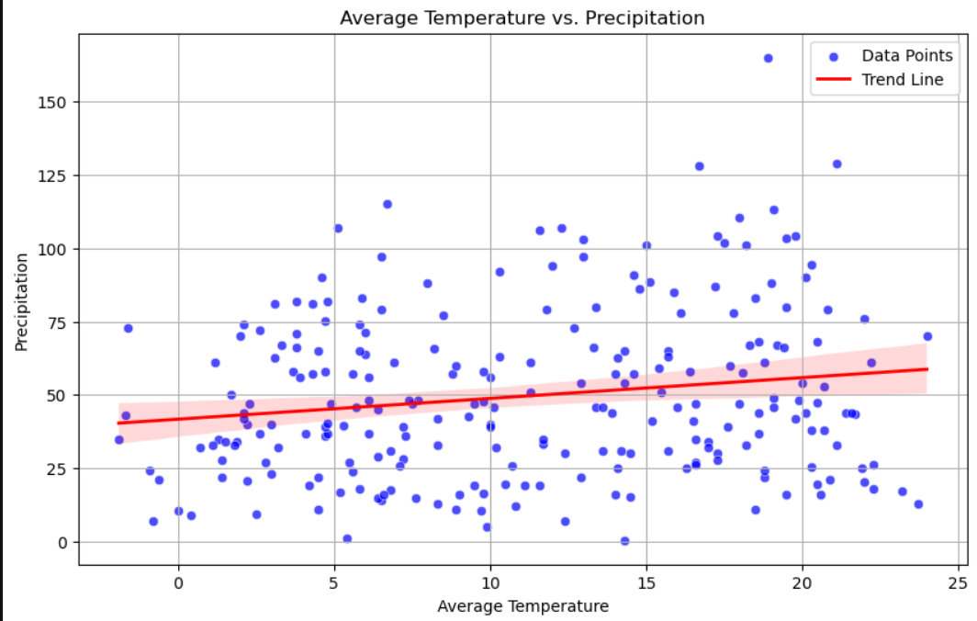

Slide 6
Scatter Plot: Average Temperature vs. Precipitation
Observation: The scatter plot shows how average temperature correlates with precipitation. The red trend line indicates a weak correlation, suggesting that changes in average temperature have a limited impact on precipitation levels.

Slide 7
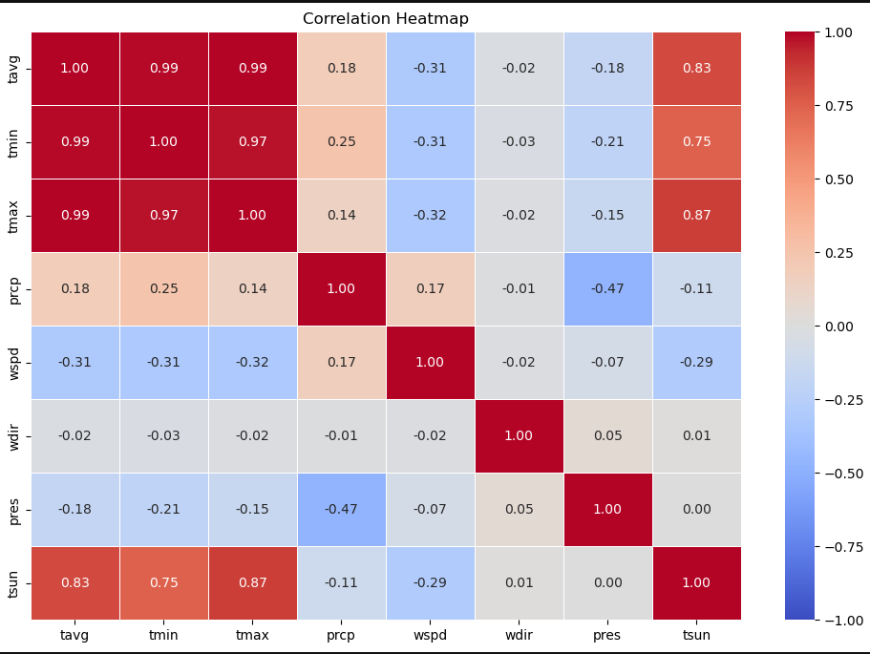

Slide 8
Correlation Heatmap:
Temperature Variables: High correlation between average, minimum, and maximum temperatures, suggesting a strong relationship between these temperature measures.
Precipitation and Temperature: Low to moderate correlation between precipitation and temperature variables, indicating that while temperature can influence precipitation, it is not the sole factor.
Other Variables: Pressure and wind speed show weaker correlations with temperature and precipitation, suggesting different underlying factors.

Slide 9
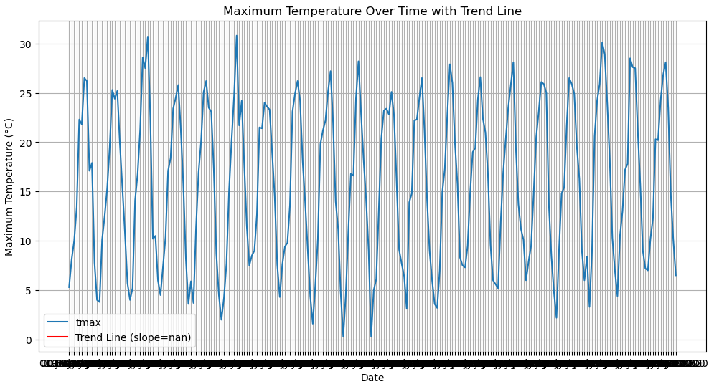

Slide 10
Maximum temperature Analysis
According to the maximum temperature data, it varies from 05 degrees Celsius to 25 degrees Celsius
The maximum temperature does not goes beyond 30 degrees Celsius. That means that the station for which the data has been analyzed not a warm place.

Slide 11
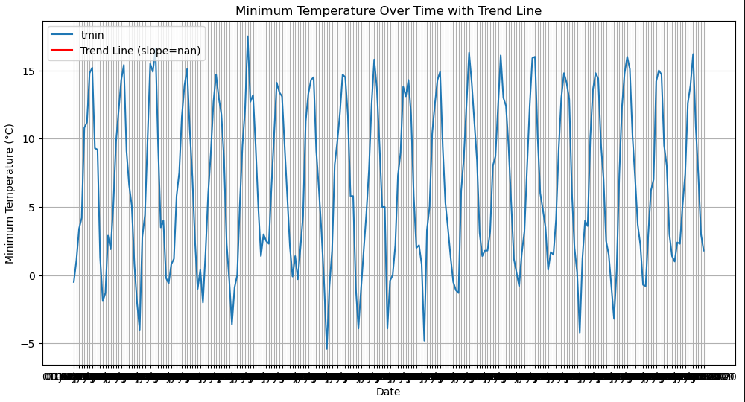
Notes:
Line Plot with Trend Line: Minimum Temperature Over Time
Observation: The line plot shows the trend in minimum temperature over time, with a red trend line indicating the overall direction. The trend line suggests that minimum temperatures have either increased or decreased over the analyzed period.

Slide 12
Minimum temperature Analysis
According to the minimum temperature data, it varies from 0 degrees Celsius to 15 degrees Celsius
In extreme winter conditions, it may reach close to -5 degrees Celsius

Slide 13
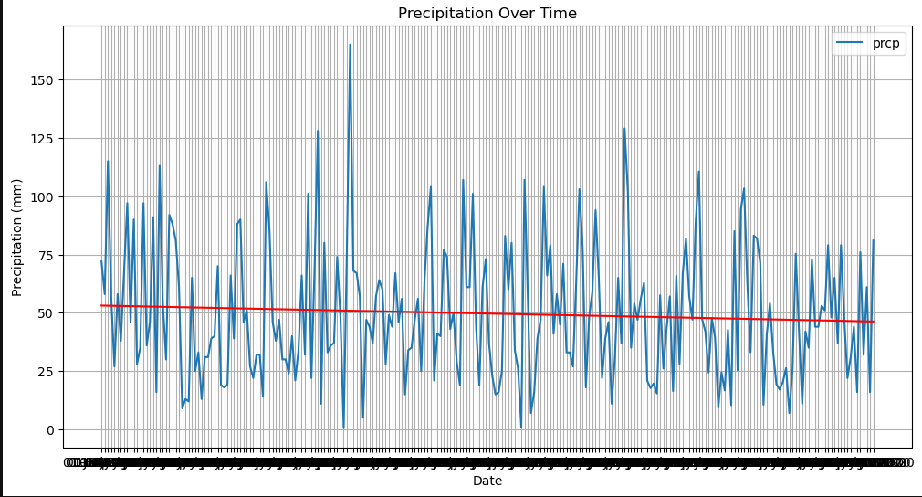

Slide 14
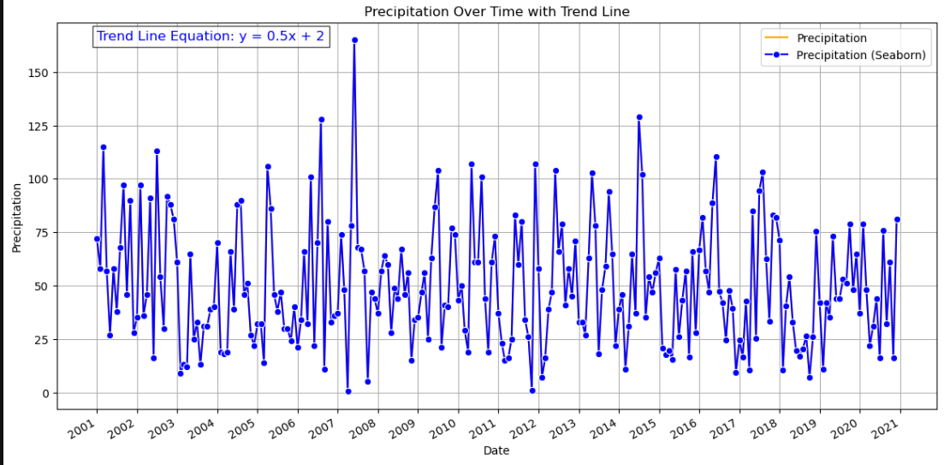

Slide 15
Rainfall over time
From the equation of the trend line, the gradient of the line is positive indicating an increase in rainfall with time.
Extreme rainfall was recorded between 2007 and 2008, which are given on the graph by the outliers

Slide 16
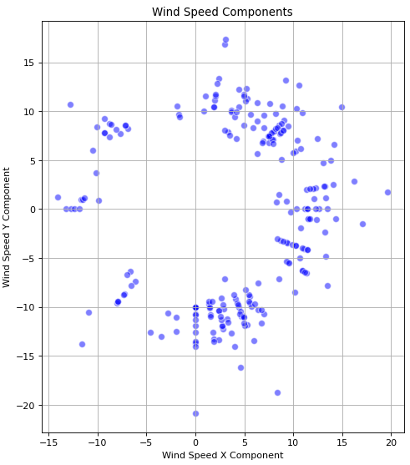
Notes:
Correlation with Other Variables: Wind speed shows weaker correlations with temperature and precipitation variables. This suggests that wind speed operates independently of temperature and precipitation to a certain extent, influenced more by local atmospheric conditions or geographic factors.

Slide 17
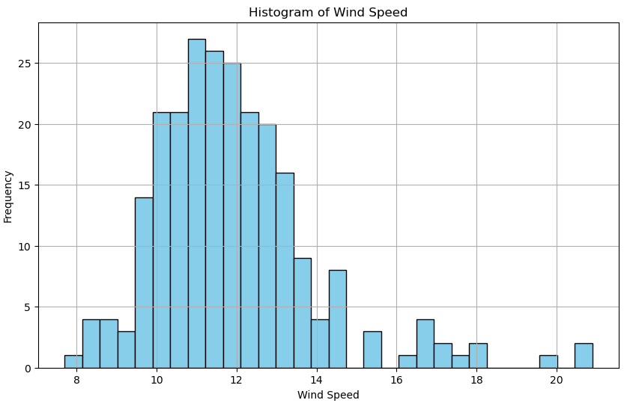

Slide 18
Wind Speed Distribution
The histogram of wind speed (wspd) shows a peak at lower wind speeds, indicating that calm conditions are more common. This right-skewed distribution suggests that high wind speeds are less frequent, with most observations clustered around lower values.

Slide 19
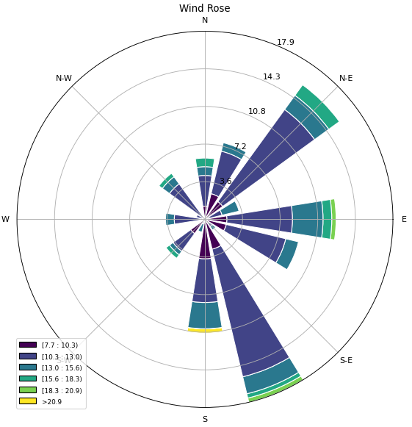

Slide 20
Windrose
From the windrose diagram, it can be deduced that wind mostly blow the north-eastern and south-eastern sector at this station
The station may be a low altitude area as the wind remains between 10 to 15 km/hr.
The maximum wind recorded is 20 km/hr

Slide 21
